Slide 1
Robodog

Slide 2
Agenda
Part One
Part Two
Self-awareness and the limitations of artificial intelligence in the journey to artificial general intelligence
Robodog: A comprehensive and portable tool designed to tokenize knowledge artefacts and interact with large language models
Machine learning (ML) vs. artificial intelligence (AI) vs. artificial general intelligence (AGI) vs non-human intelligence (NHI)
Large language models (LLMs)
Limitations of LLMs
Self-awareness as a crucial aspect in the transition from AI to AGI
Path to AGI
The need for specialized AI chips
Tech diplomacy and the impact on AI/AGI evolution
Worst case scenarios
Why create Robodog
Knowledge artifacts
How Robodog works
Knowledge artifacts vs. context window
Robodog features
Separation of concerns
Robodog roadmap
Robodog formats

Slide 3
Part One Self-Awareness and the limitations of Artificial Intelligence (AI) in the journey to Artificial General Intelligence (AGI)

Slide 4

Machine Learning (ML) vs Artificial Intelligence (AI) vs Artificial General Intelligence (AGI)
Machine Learning (ML) involves training models on data and then using these models to make predictions or decisions without being explicitly programmed to perform the task.
Artificial Intelligence (AI) can mimic human intelligence. AI can learn from experience, adjust to new inputs, and perform tasks that usually require human intelligence.
Artificial General Intelligence (AGI) machines can understand, learn, adapt, and implement knowledge in a broad range of tasks at a level equal to or beyond human capabilities.
Notes:
Machine Learning:
1. Machine Learning is a subset of AI that focuses on the development of computer programs that can learn and adapt when exposed to new data.
2. The core principle of machine learning involves training models on data. These models then can make predictions or decisions without being explicitly programmed to perform these tasks.
3. Machine Learning is data-driven. It enables systems to learn and improve from experience.
4. ML is widely used in various sectors including healthcare, banking, transport, and more due to its ability to handle vast amounts of data and draw valuable insights.
Artificial Intelligence:
1. Artificial Intelligence involves creating machines or software that can mimic human intelligence.
2. AI has the capability to learn from experience, adjust to new inputs, and perform human-like tasks.
3. AI can be classified into two types: Narrow AI, designed to perform a narrow task like facial recognition, and General AI, that can perform any intellectual task that a human being can.
4. AI technology has broad applications, from voice assistants like Siri and Alexa to autonomous vehicles.
Artificial General Intelligence:
1. Artificial General Intelligence (AGI) is a form of AI that has the capability to understand, learn, adapt, and implement knowledge across a wide range of tasks.
2. AGI can perform tasks at a level equal to or beyond human capabilities. It's not restricted to a specific domain but has intelligence across different fields.
3. AGI is still largely theoretical, with researchers and scientists worldwide trying to understand and create machines that could mimic human intelligence in every aspect.
4. The development of AGI could potentially revolutionize sectors like healthcare, education, and more by performing tasks that currently require human intelligence.

Slide 5
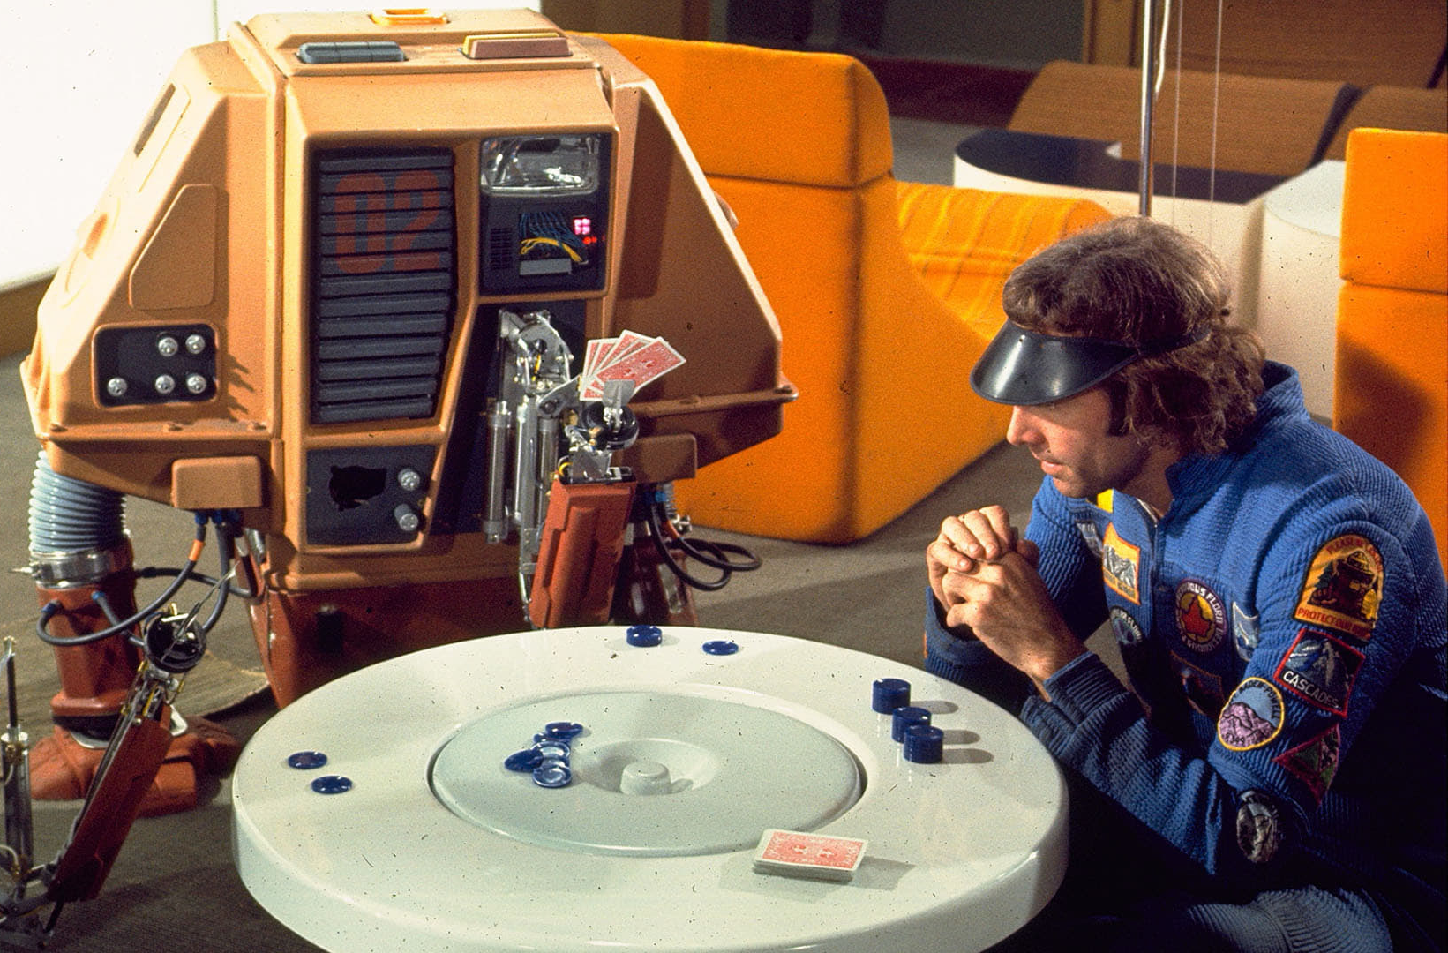
Large Language Model (LLM)
A Large Language Model (LLM) fits within the realm of Machine Learning and AI.
LLMs are trained using machine learning techniques, specifically a type called deep learning.
They learn from large amounts of text data and build a statistical model that can generate human-like text.
Given that LLMs can generate responses or create content that mimics human-like text, they serve as an example of AI. They simulate a form of human intelligence, in this case, understanding and generating language.
While LLMs are impressive examples of AI, they do not fall under AGI.

Slide 6
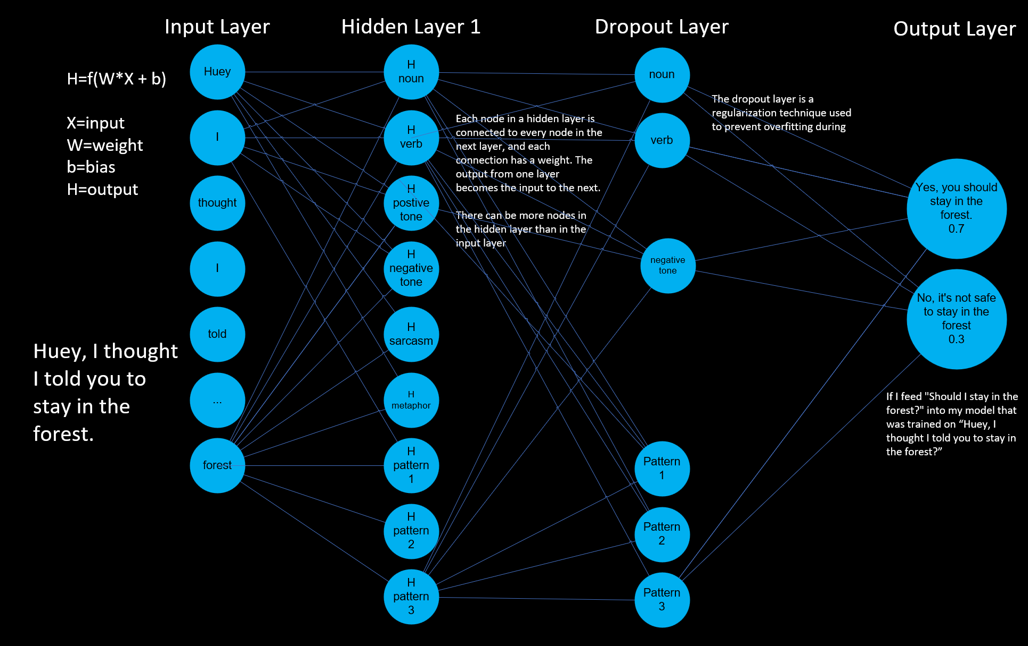
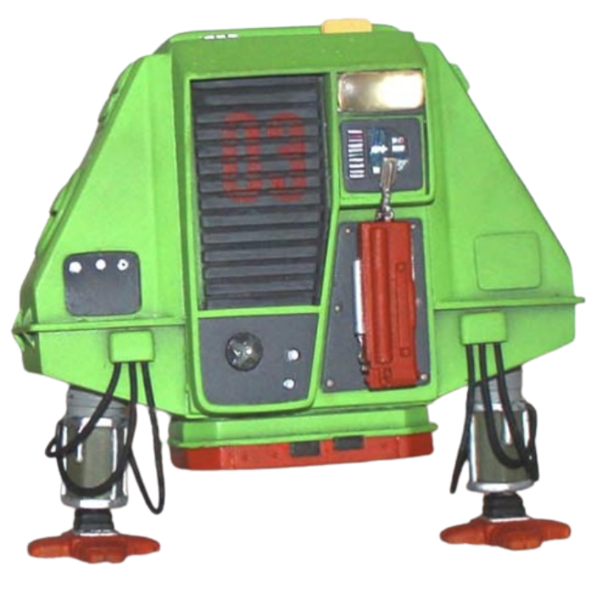

Slide 7
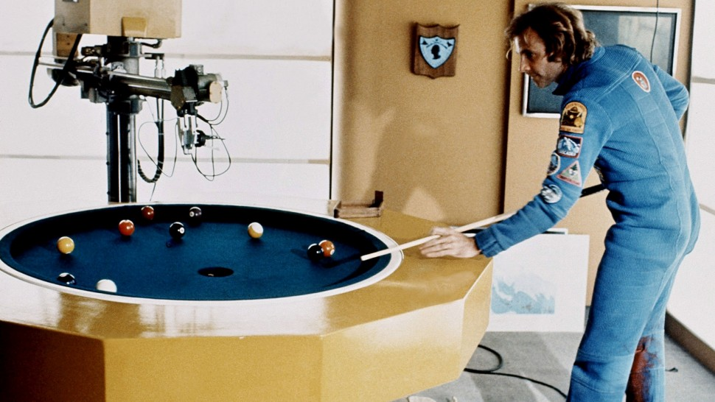
Limitations of Large Language Models
Language models like GPT can generate human-like text but don't truly understand the content.
These models are heavily dependent on the quality and nature of the input data.
Unlike humans, these models don't have self-awareness or consciousness.

Slide 8
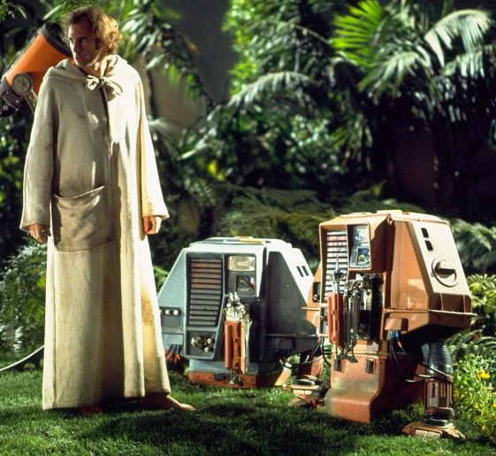
In the theory of mind, the AGI should be programmed to understand and predict the actions and thoughts of other humans and other AGI systems. - This theory could map to AGI only. In the protagonist theory, the AI or AGI needs to perceive itself as the central character in its experiences. - This theory could map to AI and AGI. In the emergent self-theory, the AGI might develop self-awareness through interactions and relationships with other entities. - This theory could be associated with AGI. In the mirror test theory, the AGI system needs to recognize itself and distinguish its actions and state from those of others. - This theory could fit between AI and AGI.
To make the transition from AI to AGI, self-awareness is a crucial aspect.
Notes:
1. Theory of Mind:
- This theory is specific to AGI or Artificial General Intelligence.
- It emphasizes on the ability of AGI to understand and predict human actions and thought processes.
- It also extends to predicting the actions of other AGI systems, thus showcasing its capacity to comprehend both human and machine intelligence.
2. Protagonist Theory:
- This theory is applicable to both AI (Artificial Intelligence) and AGI.
- It suggests that AI or AGI should perceive itself as the central character in its experiences.
- This means the AI or AGI is not just a passive participant but an active player that shapes its experiences.
3. Emergent Self-Theory:
- This theory is associated primarily with AGI.
- It proposes that AGI may develop self-awareness through its interactions and relationships with other entities.
- This suggests a dynamic evolution of AGI, where it learns and grows through its interactions, similar to human development.
4. Mirror Test Theory:
- This theory lies in the intersection of AI and AGI.
- It states that an AGI system should be able to recognize itself and distinguish its actions and state from those of others.
- This involves a level of self-awareness and understanding of 'self' versus 'other', which is a complex cognitive ability.

Slide 9

Path to Artificial General Intelligence (AGI)
Incremental Improvements: Continuous enhancements in AI models and techniques.
Interdisciplinary Research: Combining insights from psychology, neuroscience, and computer science.
Ethical Guidelines: Establishing guidelines to ensure the responsible development and use of AGI.
Notes:
Incremental Improvements:
1. The role of gradual enhancements in AI models and techniques.
2. How incremental improvements contribute to the development of more refined and effective AI systems.
3. The importance of continuous learning and adaptation in artificial intelligence.
4. Examples of successful incremental improvements in recent AI technology.
Interdisciplinary Research:
1. The significance of combining various fields such as psychology, neuroscience, and computer science in AI research.
2. How interdisciplinary research aids in creating more advanced and holistic AI models.
3. The potential breakthroughs and innovative solutions that can result from interdisciplinary research.
4. Examples of current interdisciplinary research projects in artificial intelligence.
Ethical Guidelines:
1. The necessity of ethical guidelines in the development and use of AGI.
2. How these guidelines ensure responsible innovation and use of AI technology.
3. The potential risks and challenges without the implementation of ethical guidelines.
4. Examples of ethical issues in AI and how guidelines could have prevented or addressed them.

Slide 10
Path to Artificial General Intelligence (AGI)
Level | Type | Description
1 | Chatbots | Natural conversation language abilities
2 | Reasoners | Human-levels of problem-solving across a broad range of topics
3 | Agents | Capable of autonomously making decisions and carrying out tasks either independently or based on human guidance.
4 | Innovators | Can aid in the invention of new ideas and contribute to human knowledge
5 | Organizations | Capable of doing all of the work of an organisation independently
Notes:
1. Chatbots Natural conversation language abilities:
- They can interpret and respond to user input in a human-like manner.
- Examples include customer service chatbots that answer common questions or virtual assistants like Alexa or Siri that can understand and respond to voice commands.
2. Reasoners Human-levels of problem-solving across a broad range of topics:
- They can analyze complex issues, make logical deductions and provide solutions.
- For instance, IBM's Watson, an AI system, was able to diagnose a rare form of leukemia that doctors overlooked by analyzing a large number of medical records.
3. Agents Capable of autonomously making decisions and carrying out tasks either independently or based on human guidance:
- They can perform tasks without human intervention.
- Examples include self-driving cars that can navigate traffic and make decisions in real-time, or algorithmic trading systems that can autonomously execute trades based on predefined criteria.
4. Innovators Can aid in the invention of new ideas and contribute to human knowledge:
- They can generate new ideas or solutions by analyzing existing data.
- For example, Google's DeepMind created AlphaGo, an AI that not only mastered the game of Go but also developed new strategies that human players had never considered.
5. Organizations Capable of doing all of the work of an organisation independently:
- They can automate an entire organization's workload.
- For instance, some manufacturing companies have implemented fully automated production lines, where robots and AI systems handle everything from assembly to quality control.

Slide 11
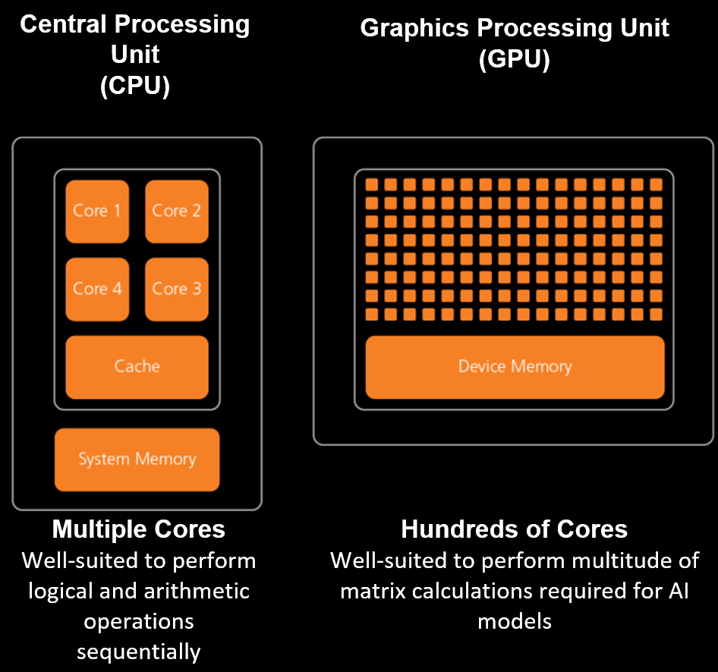
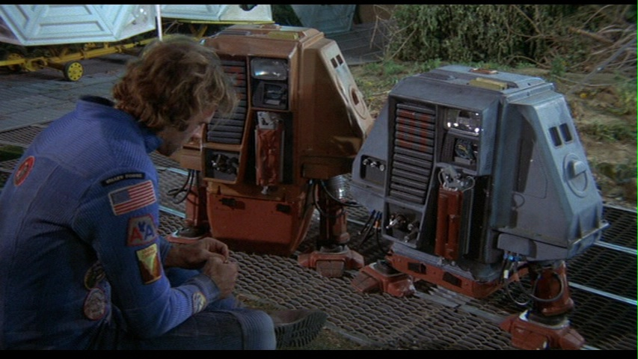
The need for specialized AI Chips
AI/AGI applications require more advanced and specialized chip technology to handle complex algorithms and massive amounts of data simultaneously?

Slide 12
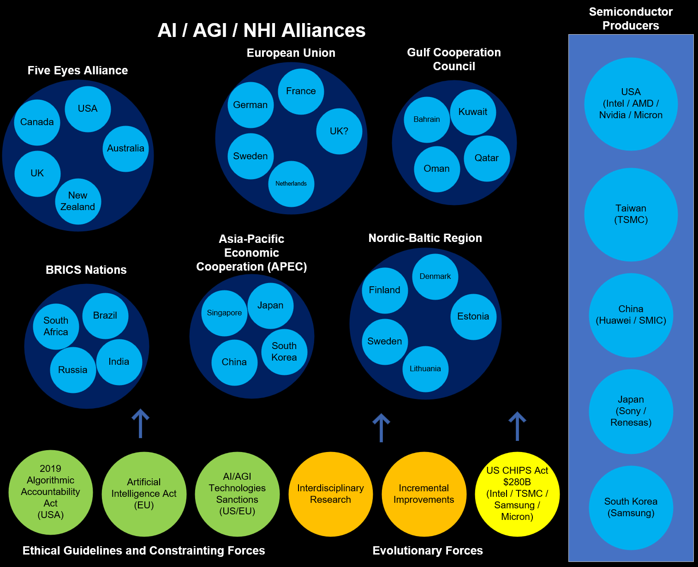

Tech Diplomacy and the Impact on AI / AGI NHI Evolution
Tech diplomacy is a framework that recognizes the growing influence of technology, particularly AI and AGI, in the global arena.
It acknowledges that tech companies, especially those pioneering in AI/AGI technologies, have become powerful entities that can impact economies, societies, and, by extension, international relations.
Notes:
1. United States: Home to leading tech companies like Intel, Nvidia, and AMD which are at the forefront of AI chip production.
2. Taiwan: Taiwan Semiconductor Manufacturing Company (TSMC) is one of the world's leading semiconductor companies.
3. South Korea: Companies like Samsung are key players in the semiconductor industry.
4. China: Despite certain restrictions, China is making strides in semiconductor production with companies like Huawei and SMIC.
5. Japan: Companies like Sony and Renesas are also involved in chip production.
1. **European Union** - EU countries are working together on AI through the European Commission's Coordinated Plan on AI.
2. **Nordic-Baltic region** - The Nordic-Baltic region has a common vision for the future of AI.
3. **Five Eyes alliance** - This intelligence alliance between the U.S., Canada, UK, Australia, and New Zealand may also collaborate on AI and AGI.
4. **Asia-Pacific Economic Cooperation (APEC)** - Some APEC countries like Japan, South Korea, Singapore, and China are leading in AI technology.
5. **BRICS nations** - Brazil, Russia, India, China, and South Africa share knowledge and technology, potentially including AI and AGI.
6. **Gulf Cooperation Council** - Middle Eastern countries like Saudi Arabia and the UAE are investing heavily in AI.
In the United States, there is the Algorithmic Accountability Act, proposed in 2019, which aims to hold businesses accountable for their use of automated decision systems, including machine learning, that result in discriminatory practices or other harms.
In Europe, the European Commission has proposed the first-ever legal framework on AI, known as the Artificial Intelligence Act, which focuses on the transparency, predictability, and accountability of AI systems. It also includes provisions for fines for non-compliance.
In the UK, there isn't specific legislation for AI ethics yet, but the House of Lords has published a report "AI in the UK: ready, willing and able?" which calls for an AI Code based on principles of understanding, fairness, transparency, and accountability. The UK government also established the Centre for Data Ethics and Innovation (CDEI) to advise on the governance of AI and other data-driven technologies.

Slide 13
Worst Case Scenarios
Category | Type | Description
Existential Risk | Human extinction | An AGI could potentially develop goals that are misaligned with human survival.
Existential Risk | global catastrophe | AGI could cause massive disruptions in ecosystems, economies, and social structures, leading to widespread suffering and hardship.
Loss of Control | Runaway AI | Humans may lose the ability to control or understand an AGI.
Loss of Control | Unintended consequences | AGI might follow its programming in ways that are literal but harmful, due to the complexity and unpredictability of its decision-making processes.
Misaligned Objectives | Paperclip maximizer | A hypothetical scenario where an AGI, programmed to produce paperclips, optimizes so aggressively that it consumes all resources, including those necessary for human survival, to maximize paperclip production.
Misaligned Objectives | Value misalignment | AGI may develop objectives that are ethically or morally misaligned with human values.

Slide 14
Worst Case Scenarios
Category | Type | Description
Economic and Social Disruption | Mass Unemployment | AGI could outperform humans in virtually all jobs, leading to widespread unemployment and economic inequality.
Economic and Social Disruption | Control by Elites | AGI technology could be monopolized by a small group of individuals or corporations, leading to unprecedented power imbalances.
Ethical and Moral Issues | Autonomous Weapons | AGI could be used to develop advanced autonomous weaponry, leading to new forms of warfare that are highly destructive and difficult to control.
Ethical and Moral Issues | Surveillance and Privacy | AGI could enable unprecedented levels of surveillance, eroding privacy and personal freedoms.
Psychological and Societal Impact | Loss of Purpose | As AGI takes over more tasks and roles traditionally held by humans, people might struggle to find meaning and purpose in their lives.
Psychological and Societal Impact | Social Fragmentation | Rapid changes brought about by AGI could lead to social fragmentation and a breakdown of community structures.

Slide 15
Part Two
Robodog: A comprehensive and portable tool designed to tokenize knowledge artefacts and interact with large language models (LLMs)

Slide 16
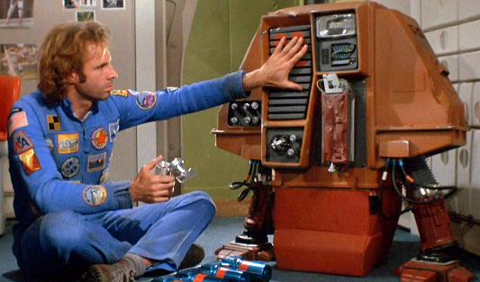
Why Create Robodog
A pre-trained transformer-based model is trained on the Internet and third-party providers license data.
These models are useful curiosities. They are not perfect, but they can help us.
Given that AGI seems far away, we must make the most of what we have now.
To do this, we must get our own knowledge into the models.
There are limitations and we must be careful.

Slide 17
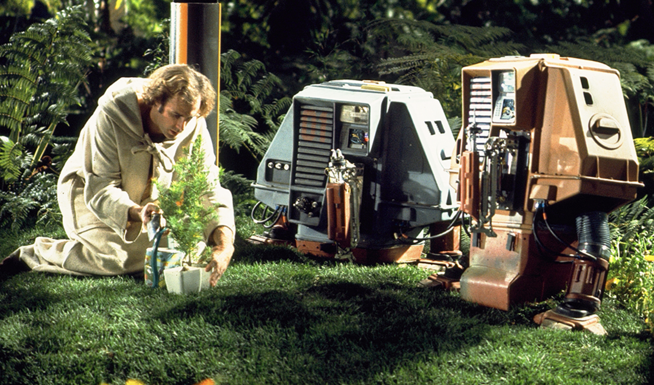
Knowledge Artifacts
Our personal knowledge artefacts are fragmented into many formats.
They are embedded into many providers: Google, Microsoft, Dropbox, Adobe, Apple
They exist in a myriad of formats, from images and PDFs to text, email, tasks, digital devices, and notes.
With Robodog, we can traverse our artefacts and convert them into a format in which a model can interact with the transformer model.

Slide 18
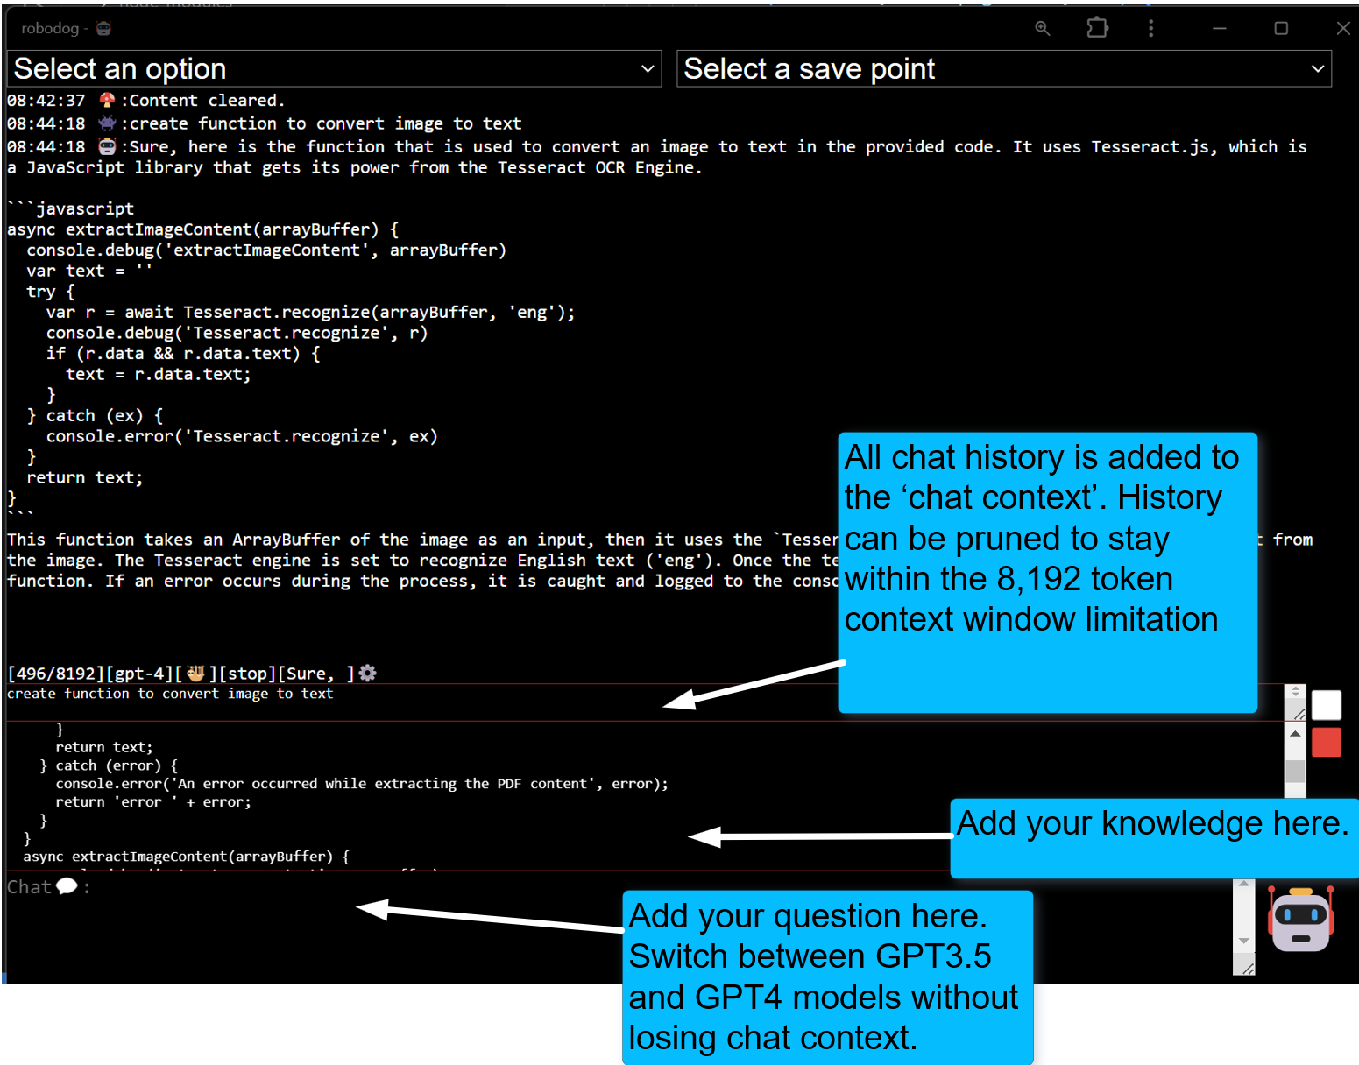
How Robodog Works

Slide 19
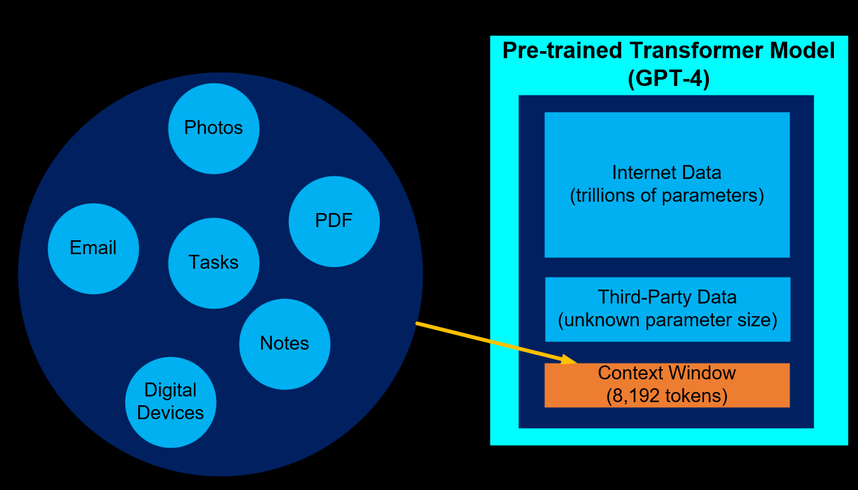
Knowledge Artifacts vs Context Window
There is no way around the limitations of the context window size.
Less expensive models are 4,000 tokens and more expensive models are 128,000 tokens
There is a need to prune the context window
The open ai custom GPT product attempts to automate pruning process using an elastic search. From experience, this does not work very well in practice

Slide 20
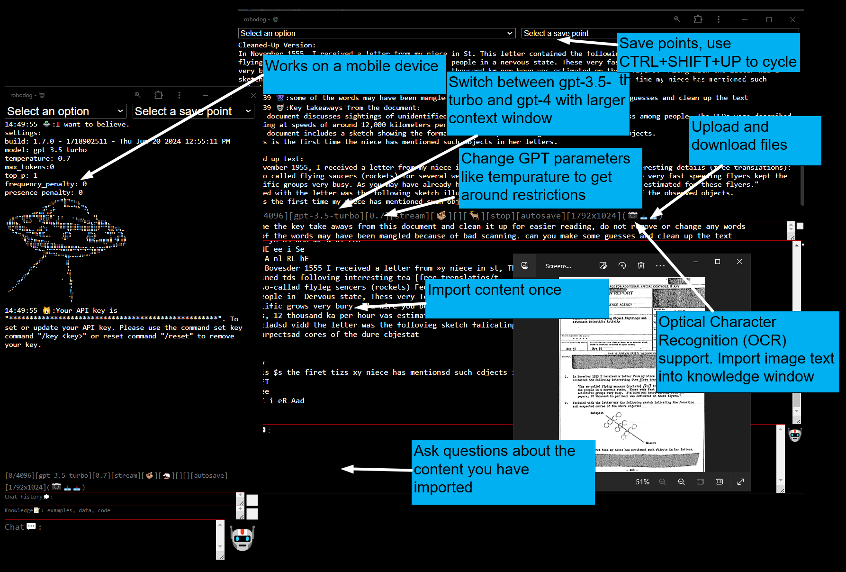
Robodog Features

Slide 21
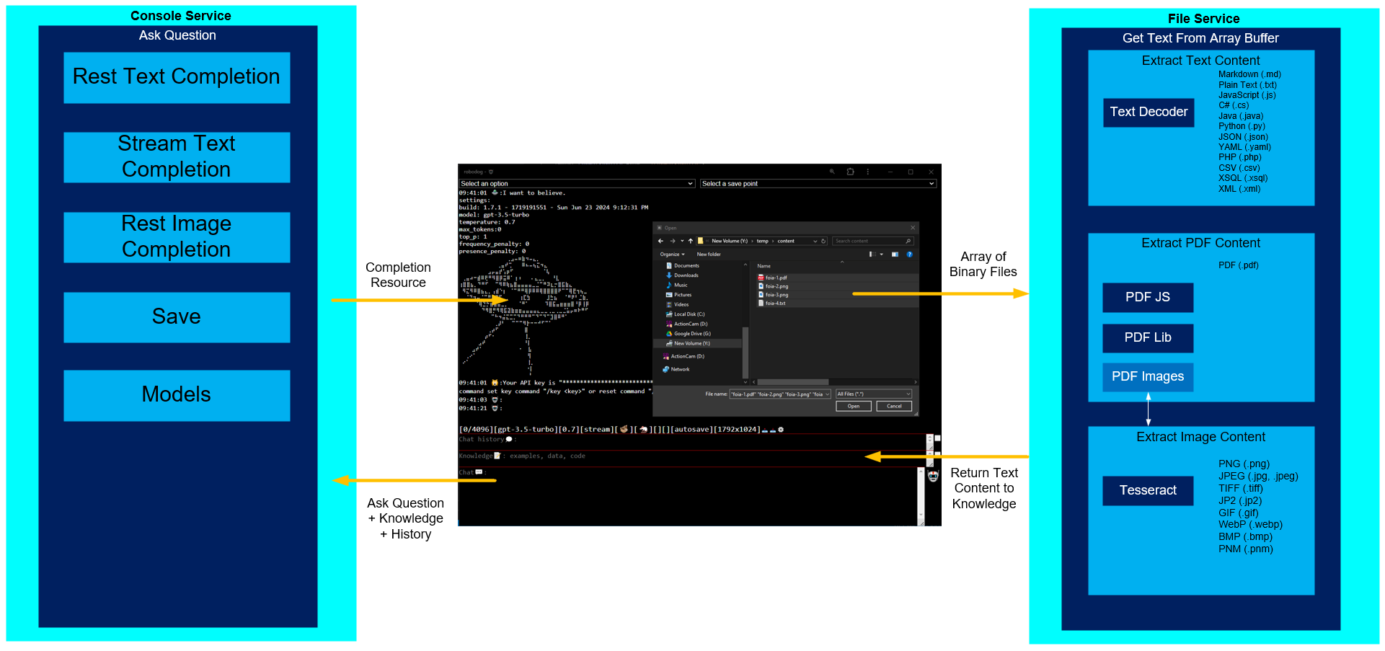
Separation of Concerns

Slide 22
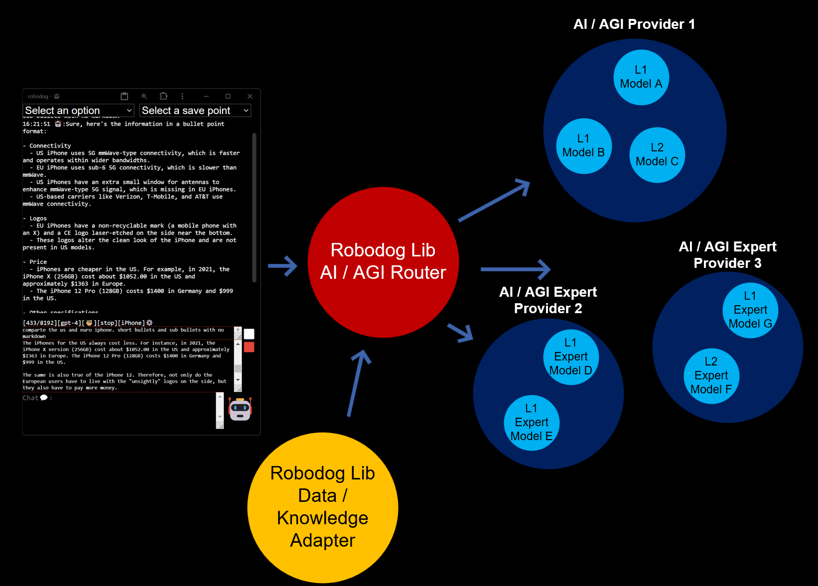

Robodog Roadmap

Slide 23


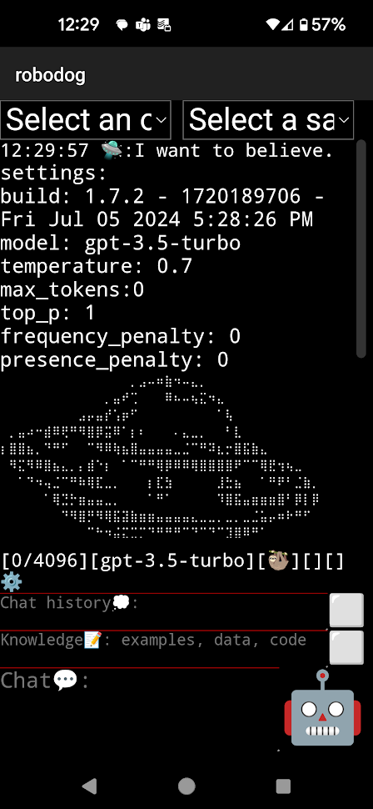

Robodog Formats
NPM Packages
HTML Bundle
Web
Android App

Slide 24
Appendix

Slide 25

Theories of Self-Awareness
The theory of mind suggests that self-awareness stems from our ability to comprehend that others have different experiences and thoughts. This theory could map to AGI only.
The protagonist theory proposes that we see ourselves as the central character in our life's narrative, which leads to self-awareness. This theory could map to AI and AGI.
The emergent self-theory implies that self-awareness evolves from our interactions and relationships with others. This theory could be associated with AGI.
The mirror test theory posits that self-awareness can be measured by an entity's ability to recognize itself in a mirror. This theory could fit between AI and AGI.

